Slide 1

Theme-Based Project :
Analyze My Career!
Team Members :
Shreya B
Shivani Komandury
Shwetha Kanamarala
Yashaswini

Slide 2
Contents :
Problem statement
User profile
Solution
Objectives
Use Cases
Market Research
Features

Slide 3

PROBLEM STATEMENT :
Do you know how much time and effort it takes to make the right choice? You’re not sure, because that’s something that you can’t guarantee on.
Students after high School depend upon the society for Career options and decisions. Well, this app helps you make choice for the right career.
What’s Next after 12th?

Slide 4

PROBLEM STATEMENT – User Profile
High School Students (Opting MPC)

Slide 5




SOLUTION
Easy-Peasy way for students to choose the right course!
Appropriate questions for students to analyze themselves and Showcase their inner talents!
Right amount of information to judge and decide properly
Choosing Career options could be dealt with in a smart way

Slide 6
Objectives : Use-Cases
Student Login
List of Questions
Multiple options to choose from
Analysis of responses
Showcase 3 branches
Information about branches depending on response
Information about Colleges & reviews
Chat Bot

Slide 7
HIGH LEVEL DESIGN
FRONT END- html, css,bootstrap 3
DATA BASE- sqlite
FRAMEWORK- Django

Slide 8
MARKET RESEARCH
Shiksha (Website) – Students are not judged based on the choices they make instead It is only relating to the streams the website provides.
Fair & Lovely (Career Foundation) – Only specific names are provided depending upon the responses, without any additional information and reviews.
An estimated 26.5 million students enroll in Indian higher education and 9 million people graduate every year.
Nearly, one out of six students enroll in bachelor’s degree programs (four-year engineering) and rest are in three-year degrees.

Slide 9
FEATURES
Attempt questions and make the right choice according to your interests.
Choices of Engineering Branches will be provided basing on the response.
Add-on feature - List of Colleges with reviews can be accessed using the search bar.
Branches that are shown can be selected to analyze all the information relating to that particular branch.
Determine your career Accurately
Chat Bot

Slide 10
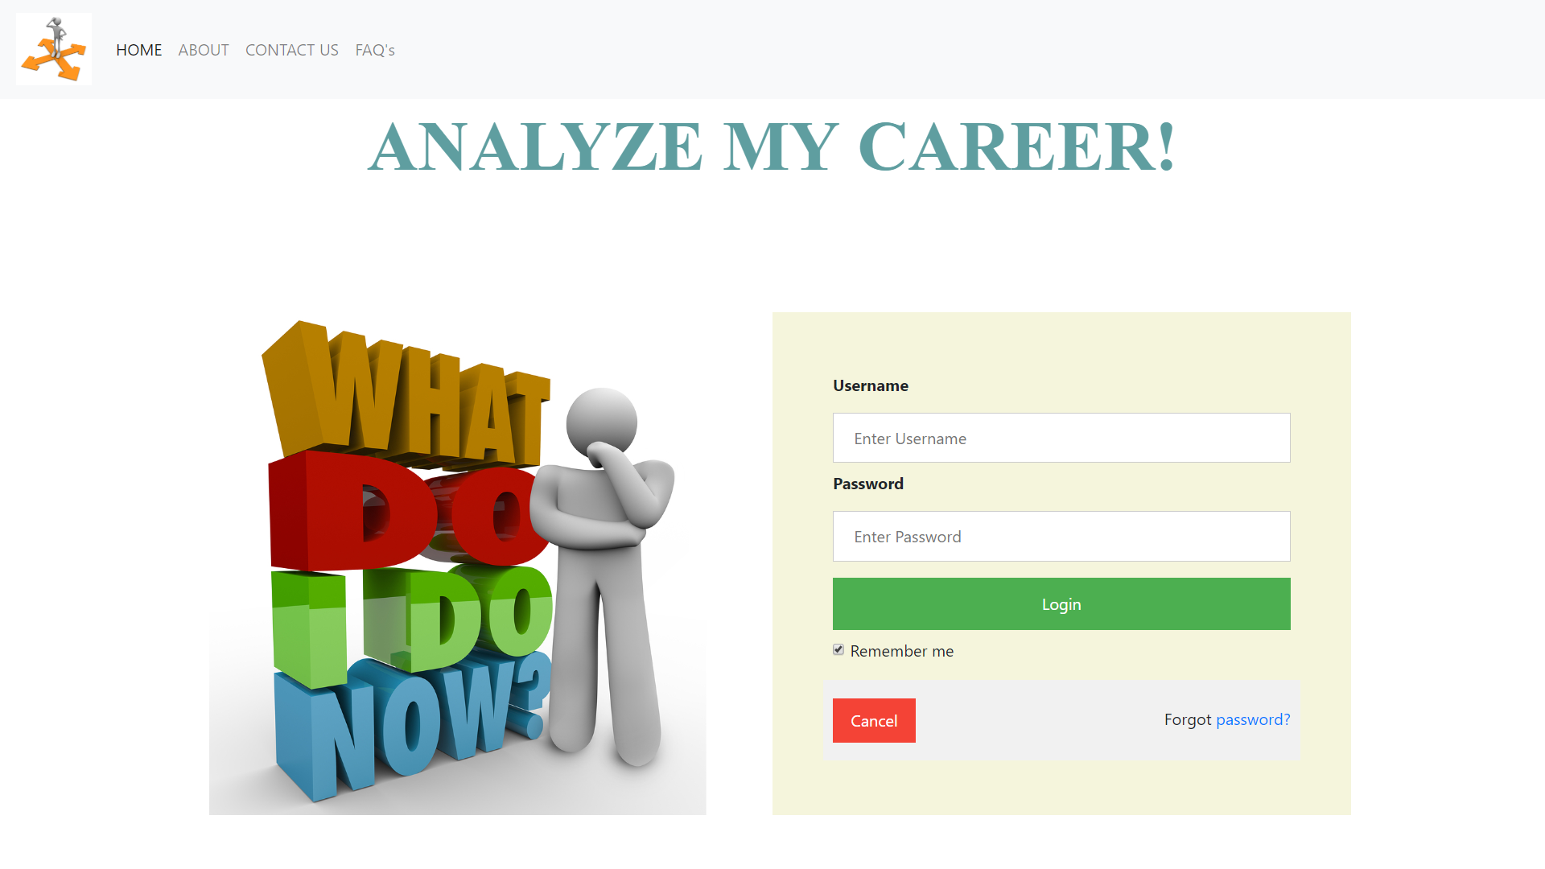
SCREEN 1

Slide 11
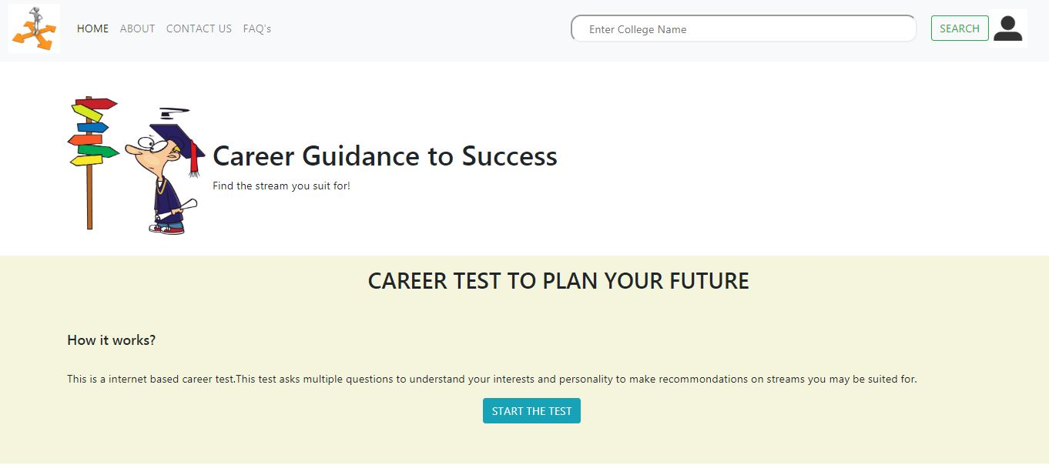
SCREEN 2

Slide 12
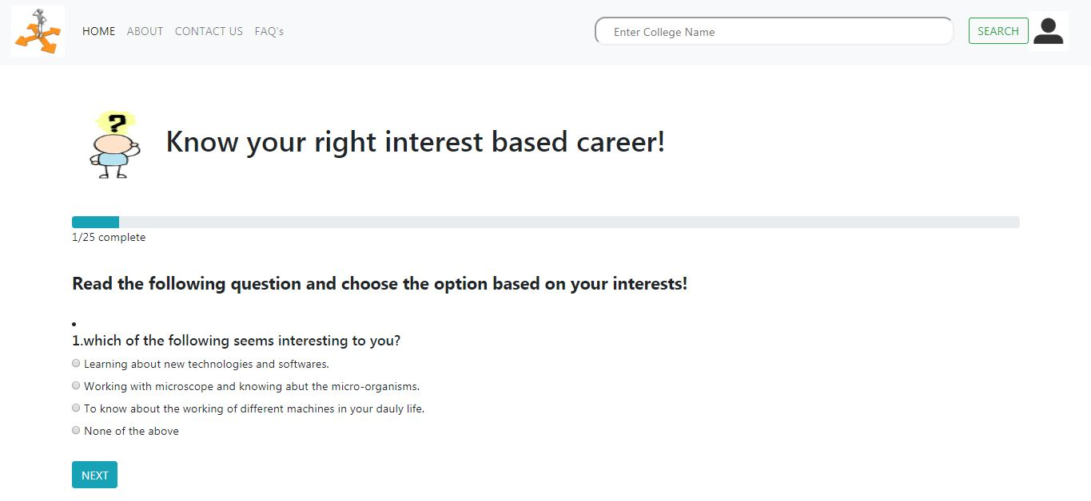
SCREEN 3

Slide 13
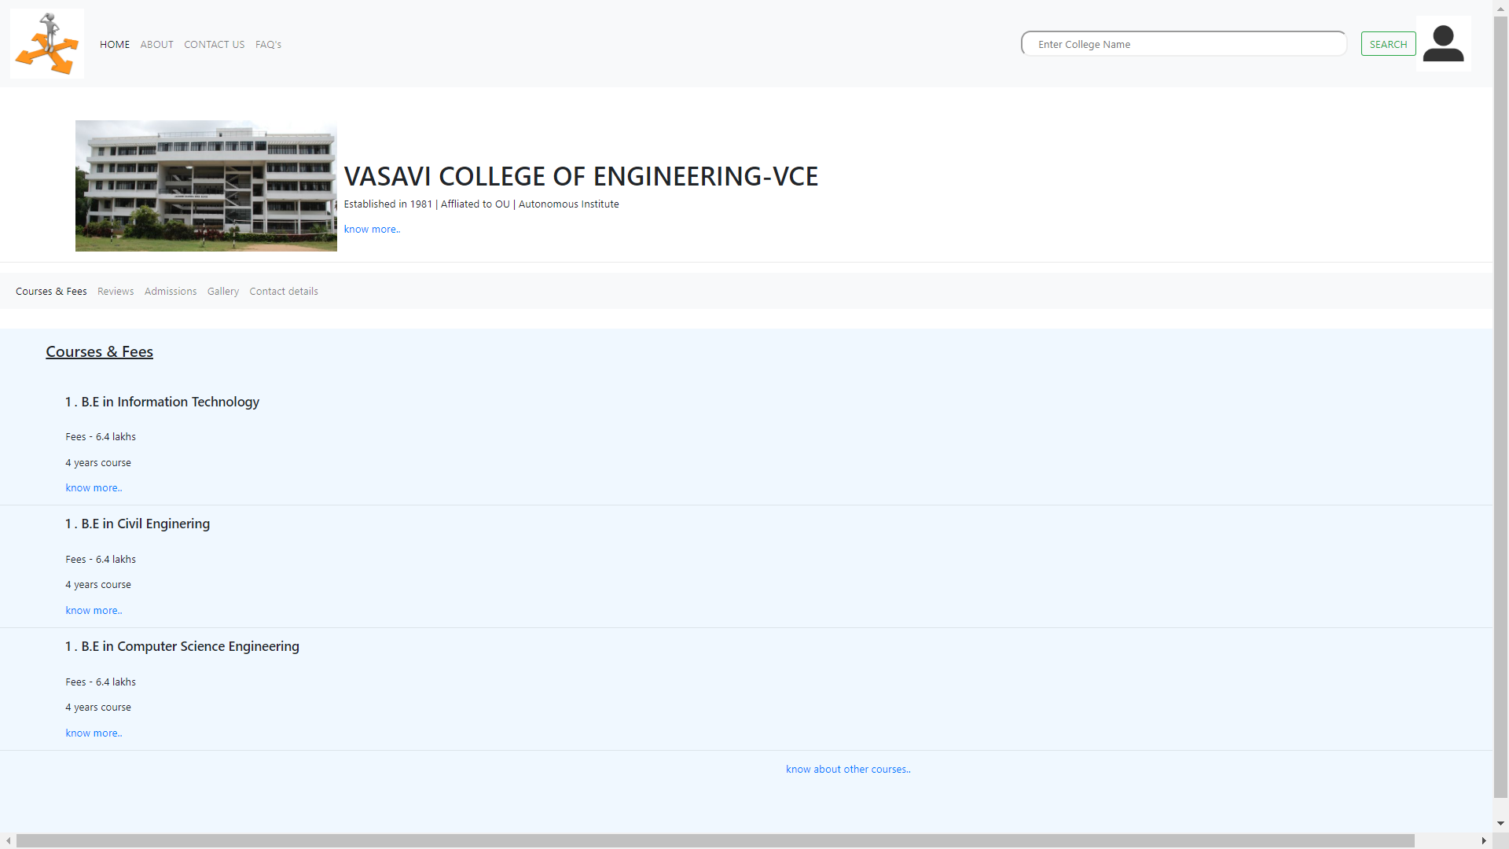
SCREEN 4

Slide 14
THANK YOU! ☺

